Slide 1
Operating-System Services

Slide 2
Operating System Services
Operating systems provide an environment for execution of programs and services to programs and users
One set of operating-system services provides functions that are helpful to the user:
User interface - Almost all operating systems have a user interface (UI).
Varies between Command-Line (CLI), Graphics User Interface (GUI), touch-screen, Batch
Program execution - The system must be able to load a program into memory and to run that program, end execution, either normally or abnormally (indicating error)
I/O operations - A running program may require I/O, which may involve a file or an I/O device
File-system manipulation - The file system is of particular interest. Programs need to read and write files and directories, create and delete them, search them, list file Information, permission management.

Slide 3
Operating System Services (Cont.)
One set of operating-system services provides functions that are helpful to the user (Cont.):
Communications – Processes may exchange information, on the same computer or between computers over a network
Communications may be via shared memory or through message passing (packets moved by the OS)
Error detection – OS needs to be constantly aware of possible errors
May occur in the CPU and memory hardware, in I/O devices, in user program
For each type of error, OS should take the appropriate action to ensure correct and consistent computing
Debugging facilities can greatly enhance the user’s and programmer’s abilities to efficiently use the system

Slide 4
Operating System Services (Cont.)
Another set of OS functions exists for ensuring the efficient operation of the system itself via resource sharing
Resource allocation - When multiple users or multiple jobs running concurrently, resources must be allocated to each of them
Many types of resources - CPU cycles, main memory, file storage, I/O devices.
Logging - To keep track of which users use how much and what kinds of computer resources
Protection and security - The owners of information stored in a multiuser or networked computer system may want to control use of that information, concurrent processes should not interfere with each other
Protection involves ensuring that all access to system resources is controlled
Security of the system from outsiders requires user authentication, extends to defending external I/O devices from invalid access attempts

Slide 5
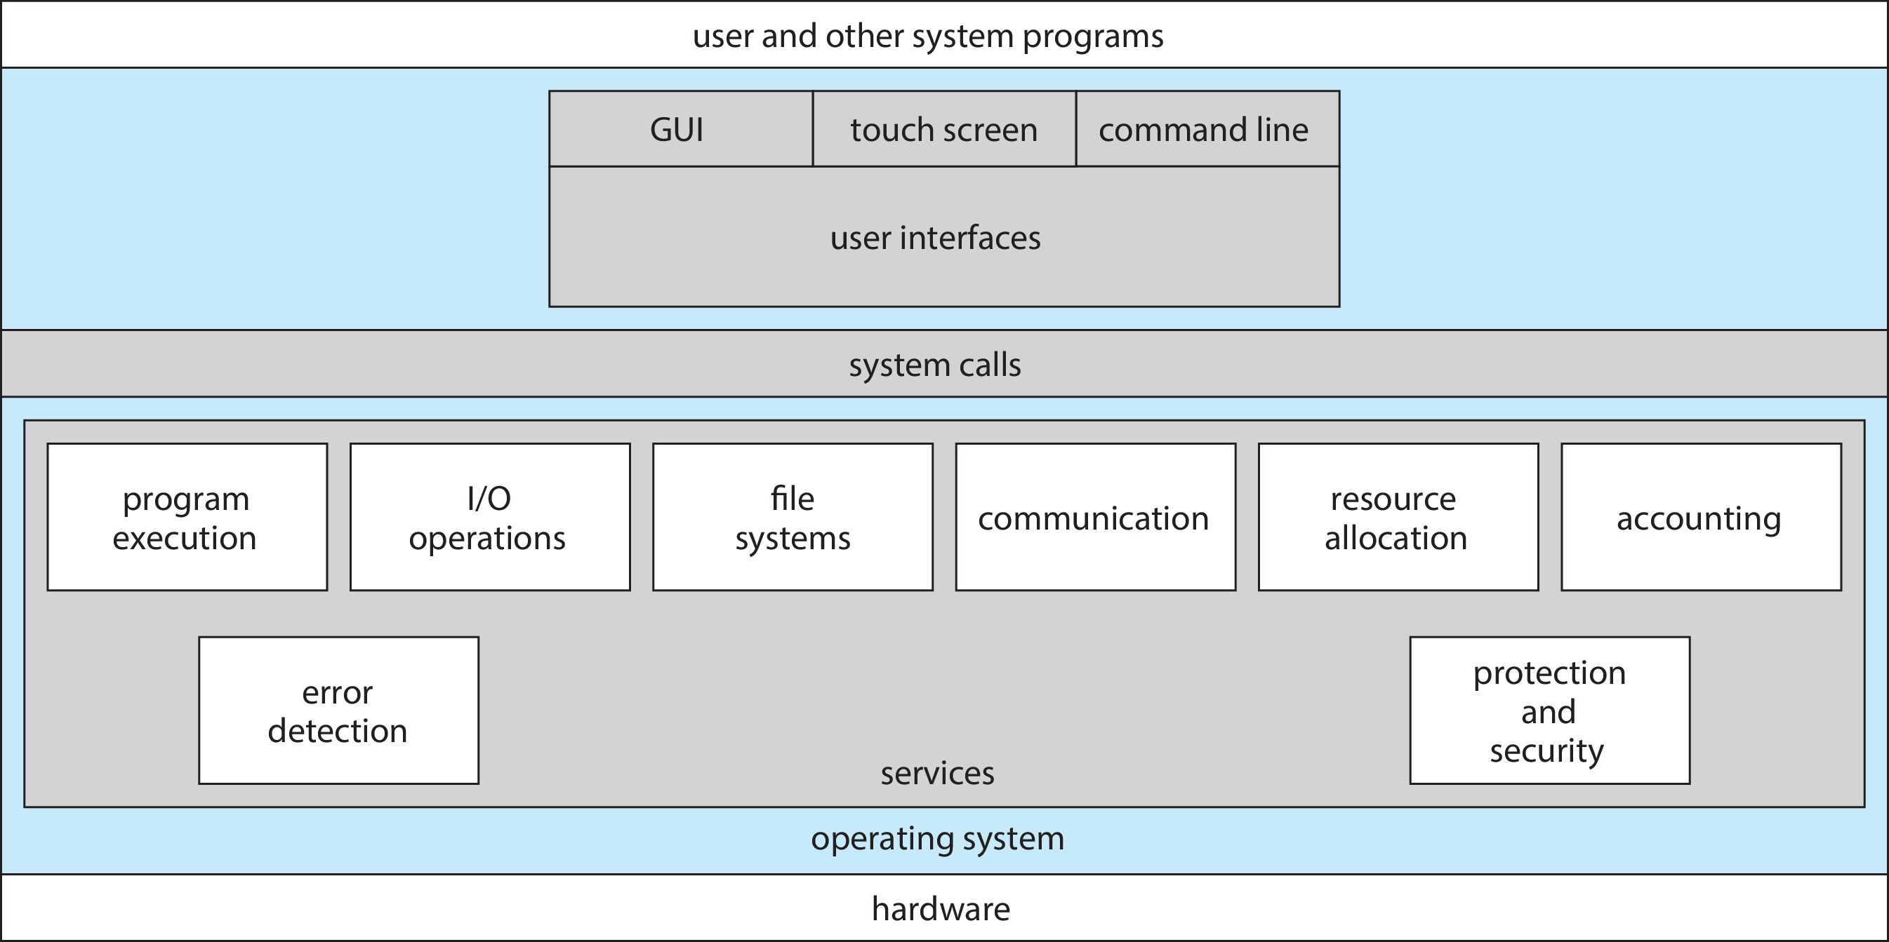
A View of Operating System Services

Slide 6
Command Line interpreter
CLI allows direct command entry
Sometimes implemented in kernel, sometimes by systems program
Sometimes multiple flavors implemented – shells
Primarily fetches a command from user and executes it
Sometimes commands built-in, sometimes just names of programs
If the latter, adding new features doesn’t require shell modification

Slide 7
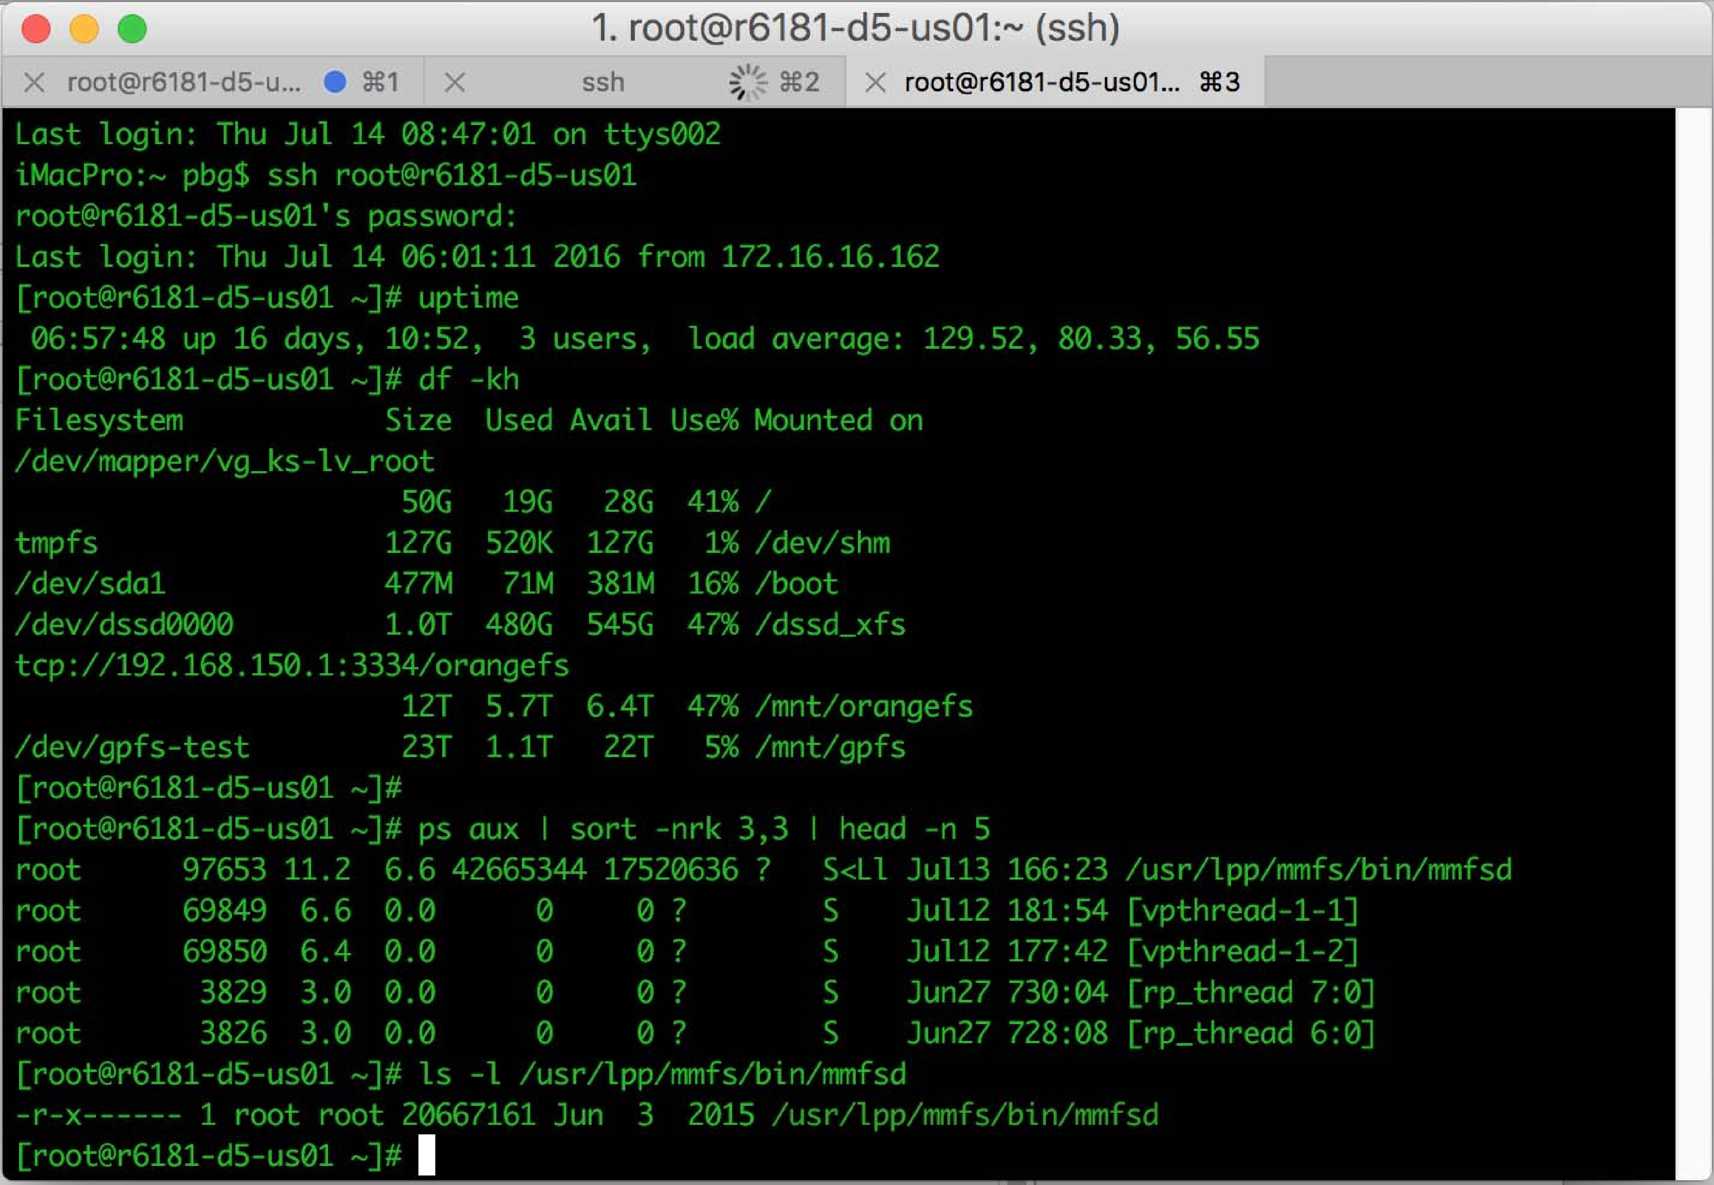
Bourne Shell Command Interpreter

Slide 8

Touchscreen Interfaces
Touchscreen devices require new interfaces
Mouse not possible or not desired
Actions and selection based on gestures
Virtual keyboard for text entry
Voice commands

Slide 9
System Calls
Programming interface to the services provided by the OS
Typically written in a high-level language (C or C++)
Mostly accessed by programs via a high-level Application Programming Interface (API) rather than direct system call use
Three most common APIs are Win32 API for Windows, POSIX API for POSIX-based systems (including virtually all versions of UNIX, Linux, and Mac OS X), and Java API for the Java virtual machine (JVM)
Note that the system-call names used throughout this text are generic

Slide 10
System Call Implementation
Typically, a number is associated with each system call
System-call interface maintains a table indexed according to these numbers
The system call interface invokes the intended system call in OS kernel and returns status of the system call and any return values
The caller need know nothing about how the system call is implemented
Just needs to obey API and understand what OS will do as a result call
Most details of OS interface hidden from programmer by API
Managed by run-time support library (set of functions built into libraries included with compiler)

Slide 11

API – System Call – OS Relationship

Slide 12
System Call Parameter Passing
Often, more information is required than simply identity of desired system call
Exact type and amount of information vary according to OS and call
Three general methods used to pass parameters to the OS
Simplest: pass the parameters in registers
In some cases, may be more parameters than registers
Parameters stored in a block, or table, in memory, and address of block passed as a parameter in a register
This approach taken by Linux and Solaris
Parameters placed, or pushed, onto the stack by the program and popped off the stack by the operating system
Block and stack methods do not limit the number or length of parameters being passed

Slide 13
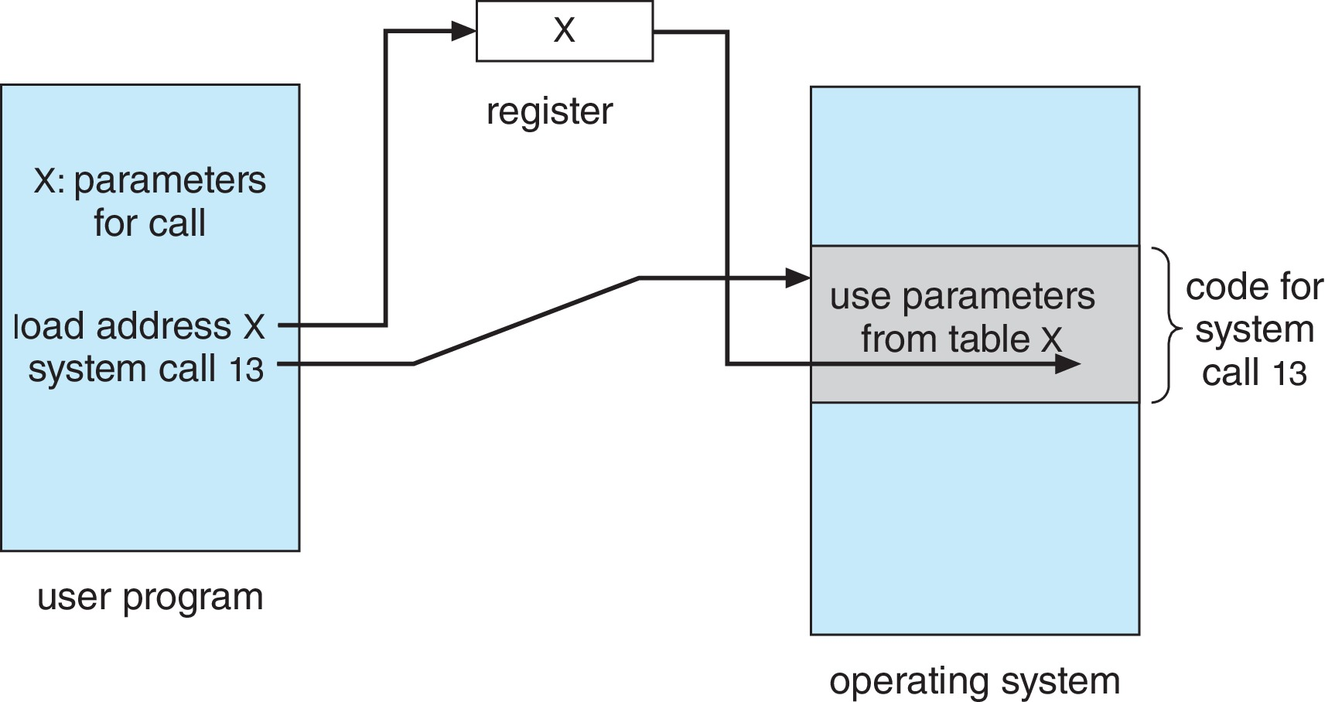
Parameter Passing via Table

Slide 14
Types of System Calls
Process control
create process, terminate process
end, abort
load, execute
get process attributes, set process attributes
wait for time
wait event, signal event
allocate and free memory
Dump memory if error
Debugger for determining bugs, single step execution
Locks for managing access to shared data between processes

Slide 15
Types of System Calls (Cont.)
File management
create file, delete file
open, close file
read, write, reposition
get and set file attributes
Device management
request device, release device
read, write, reposition
get device attributes, set device attributes
logically attach or detach devices

Slide 16
Types of System Calls (Cont.)
Information maintenance
get time or date, set time or date
get system data, set system data
get and set process, file, or device attributes
Communications
create, delete communication connection
send, receive messages if message passing model to host name or process name
From client to server
Shared-memory model create and gain access to memory regions
transfer status information
attach and detach remote devices

Slide 17
Types of System Calls (Cont.)
Protection
Control access to resources
Get and set permissions
Allow and deny user access

Slide 18
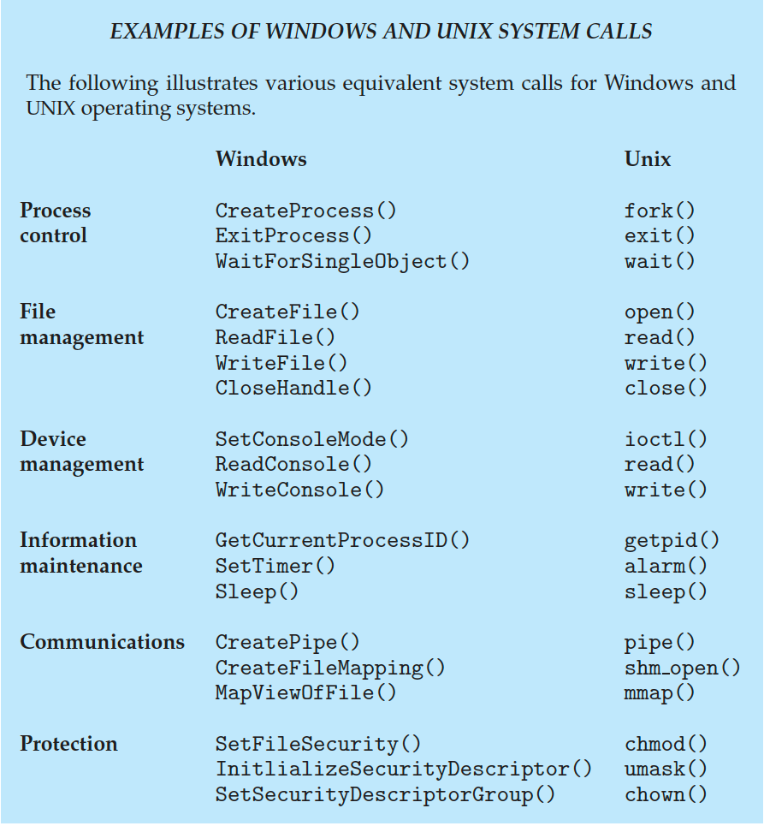
Examples of Windows and Unix System Calls

Slide 19
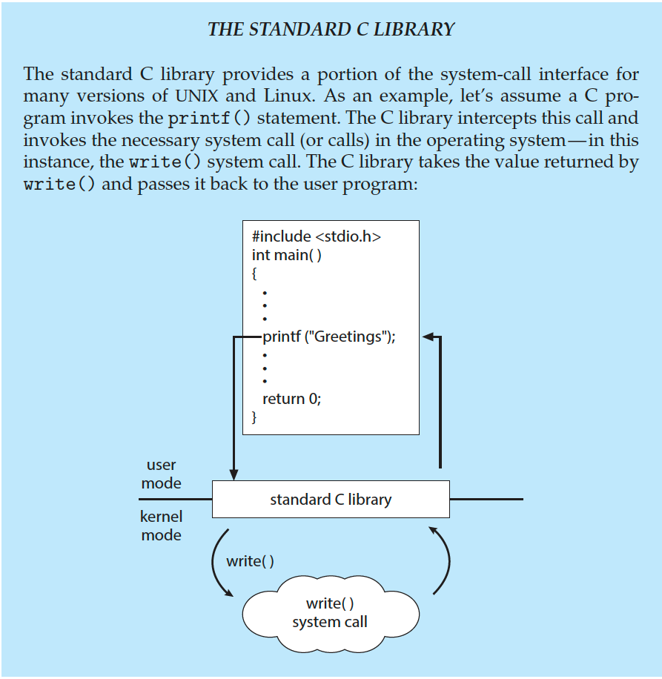
Standard C Library Example
C program invoking printf() library call, which calls write() system call

Slide 20
System Services
System programs provide a convenient environment for program development and execution. They can be divided into:
File manipulation
Status information sometimes stored in a file
Programming language support
Program loading and execution
Communications
Background services
Application programs
Most users’ view of the operating system is defined by system programs, not the actual system calls

Slide 21
System Services (Cont.)
Provide a convenient environment for program development and execution
Some of them are simply user interfaces to system calls; others are considerably more complex
File management - Create, delete, copy, rename, print, dump, list, and generally manipulate files and directories
Status information
Some ask the system for info - date, time, amount of available memory, disk space, number of users
Others provide detailed performance, logging, and debugging information
Typically, these programs format and print the output to the terminal or other output devices
Some systems implement a registry - used to store and retrieve configuration information

Slide 22
System Services (Cont.)
File modification
Text editors to create and modify files
Special commands to search contents of files or perform transformations of the text
Programming-language support - Compilers, assemblers, debuggers and interpreters sometimes provided
Program loading and execution- Absolute loaders, relocatable loaders, linkage editors, and overlay-loaders, debugging systems for higher-level and machine language
Communications - Provide the mechanism for creating virtual connections among processes, users, and computer systems
Allow users to send messages to one another’s screens, browse web pages, send electronic-mail messages, log in remotely, transfer files from one machine to another

Slide 23
Operating System Structure
General-purpose OS is very large program
Various ways to structure ones
Simple structure – MS-DOS
More complex – UNIX
Layered – an abstraction
Microkernel – Mach

Slide 24
Monolithic Structure – Original UNIX
UNIX – limited by hardware functionality, the original UNIX operating system had limited structuring.
The UNIX OS consists of two separable parts
Systems programs
The kernel
Consists of everything below the system-call interface and above the physical hardware
Provides the file system, CPU scheduling, memory management, and other operating-system functions; a large number of functions for one level

Slide 25

Traditional UNIX System Structure
Beyond simple but not fully layered

Slide 26

Linux System Structure
Monolithic plus modular design

Slide 27

Layered Approach
The operating system is divided into a number of layers (levels), each built on top of lower layers. The bottom layer (layer 0), is the hardware; the highest (layer N) is the user interface.
With modularity, layers are selected such that each uses functions (operations) and services of only lower-level layers

Slide 28
Microkernels
Moves as much from the kernel into user space
Mach is an example of microkernel
Mac OS X kernel (Darwin) partly based on Mach
Communication takes place between user modules using message passing
Benefits:
Easier to extend a microkernel
Easier to port the operating system to new architectures
More reliable (less code is running in kernel mode)
More secure
Detriments:
Performance overhead of user space to kernel space communication

Slide 29
Microkernel System Structure

Slide 30
Modules
Many modern operating systems implement loadable kernel modules (LKMs)
Uses object-oriented approach
Each core component is separate
Each talks to the others over known interfaces
Each is loadable as needed within the kernel
Overall, similar to layers but with more flexible
Linux, Solaris, etc.

